Slide 1
Effects of working memory training
on reading in children
with special needs
Human Factors Psychology Lab,
Seoul National University
Summer 2019
{Karin I. E. Dahlin (2011)} {Reading and Writing}
Presented by {Soomin Cho}
Notes:
For 10 to 15 minute talk, don’t make more than 20 slides.

Slide 2
Contents
Abstract
Introduction
Hypothesis
Methods
Results
Discussion

Slide 3
Abstract
Purpose: Working memory of children with special needs could be enhanced by a cognitive training program
Hypothesis: High correlations between working memory and reading comprehension skills
Methods: Neuropsychological measures and Reading measures
Results: Working memory works as a crucial factor in the reading development

Slide 4
2. Introduction
Past
Working memory has a limited capacity
Present studies
children with ADHD may benefit in their behavior from working memory training
Increased brain activity is associated with working memory functions

Slide 5
3. Hypothesis
Working Memory ability would increase through the training with a positive effect on children’s reading comprehension skills

Slide 6
4. Methods
Fifty-seven children with special education needs
11 girls and 46 boys
in grades 3–5
ages ranging from 9 to 12 years

Slide 7
4. Methods
4-1. Neuropsychological Measures
Nonverbal reasoning ability
Verbal working memory
Visual-spatial working memory
Response inhibition

Slide 8
4. Methods
Nonverbal reasoning ability
Raven’s Coloured Progressive Matrices
Verbal working memory
Digit Span
Visual-spatial working memory
Span Board
Response inhibition
Stroop

Slide 9
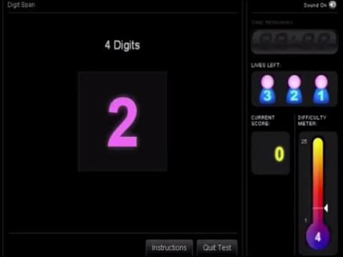
Digit Span

Slide 10
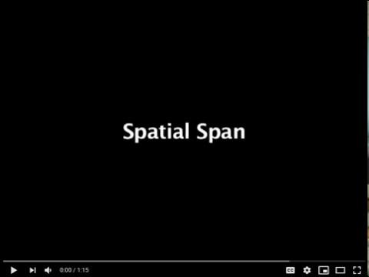
Spatial Span

Slide 11
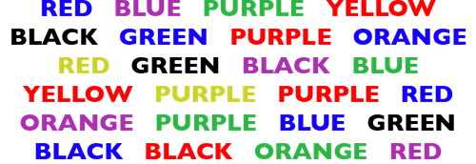
Stroop

Slide 12
4. Methods
4-2. Reading Measures
Reading comprehension
Word decoding
Orthographic knowledge

Slide 13
4. Methods
Reading Comprehension
Narrative texts from the Progress in International Reading Literacy Study
Word Decoding
the Phonological non-word reading test
Orthographic knowledge
The Orthographic verification test

Slide 14
4. Methods
Completing a set of assessments
nonverbal reasoning
working memory
Reading
2. Within the same time intervals
Pre-test
post-test, 5–6 weeks later
Post-test, 6–7 months later.

Slide 15
5. Results
The effect of training was tested by comparing the outcome score at post-test in the treatment group scores at pre-test.
Four measurements were improved
Span Board forward
Span Board backward
Digit backward
Nonverbal problem solving (Raven)

Slide 16
5. Results
The treatment group enhanced its results of working memory measures
The WM measures Span board forward and back were related to reading comprehension
Comparison of the experimental group with an additional control group showed that the training indeed enhanced children’s working memory.

Slide 17
6. Discussion
Limitation
a large difference in size between the treatment group and the control group
including more children in the treatment group.
Practical Implication
WM training may facilitate reading comprehension processes directly, and not via improvements in word-level reading processes.

Slide 18
Thank you
For Your Attention

